Slide 1
CHURN ANALYTICS
Project Report
Rashika Singhal

Slide 2

Objective
To design a dashboard for a business to gain insights into the churning behaviour of customers.
To identify the reasons behind the churning of customers by running various python code

Slide 3
Benefits
The dashboard and python code will help company
Understand the reasons behind the customers’ churning.
Which services need to be improved.

Slide 4
Problem Statement
A business is dealing with client attrition. The main goal is to precisely evaluate the customers’ churning rate and churned customers count and the factors responsible for it in order to help the business gain insights into the services that it needs to improve.

Slide 5
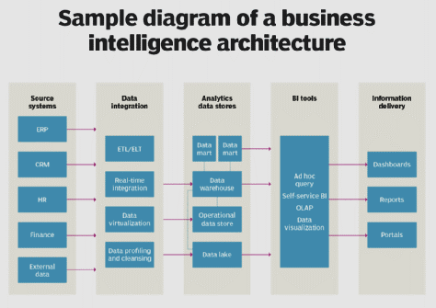
Architecture

Slide 6
Dataset
The dataset of the company is provided in the form of Excel workbook.
The dataset contains the following columns:
Agency, Commendation or Complaint, Subject Matter, Subject Detail, Issue Detail, Year, Quarter, Line/Route/Branch

Slide 7
Data Transformation
The null values of the Issue Detail column have been replaced by the ‘Unspecified’ text.
The duplicate entries are removed.
In this way, the data has been cleaned.

Slide 8


Tools Used
Power BI is used to make the Churn Analytics Dashboard.
Jupyter Notebook is used to run various pandas code to understand the data.

Slide 9
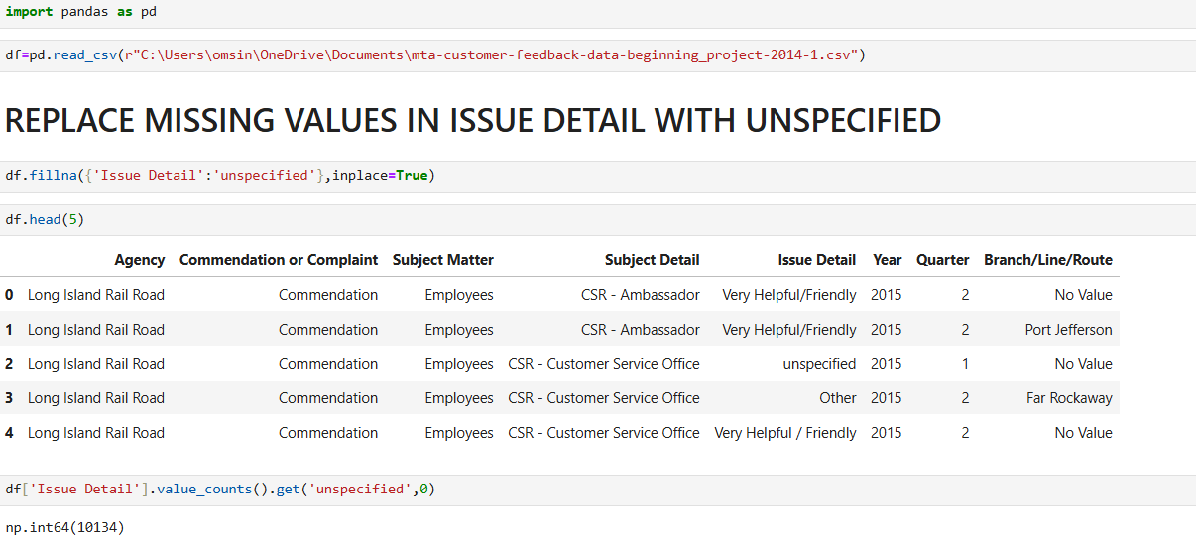
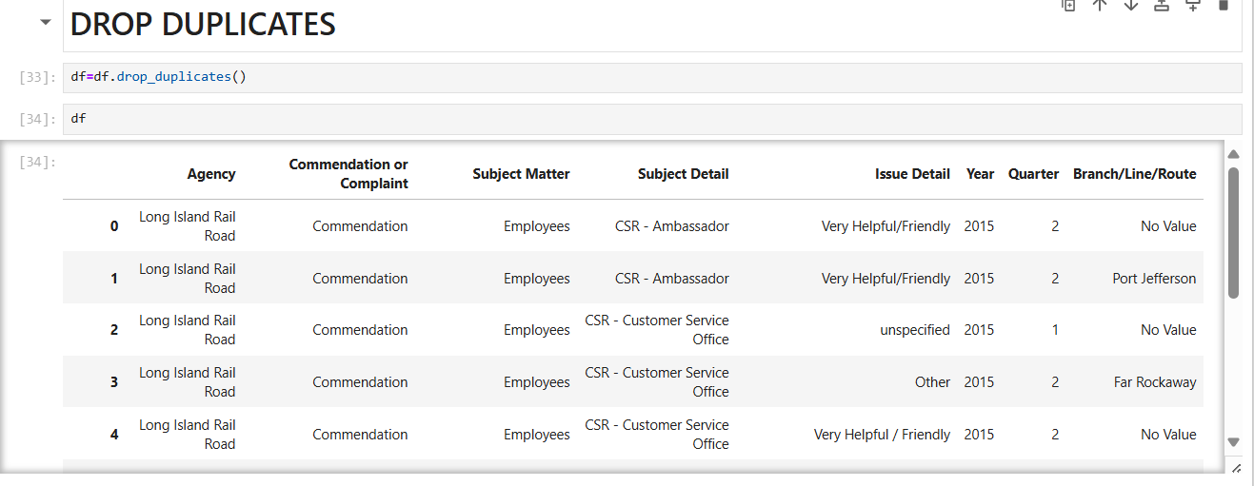
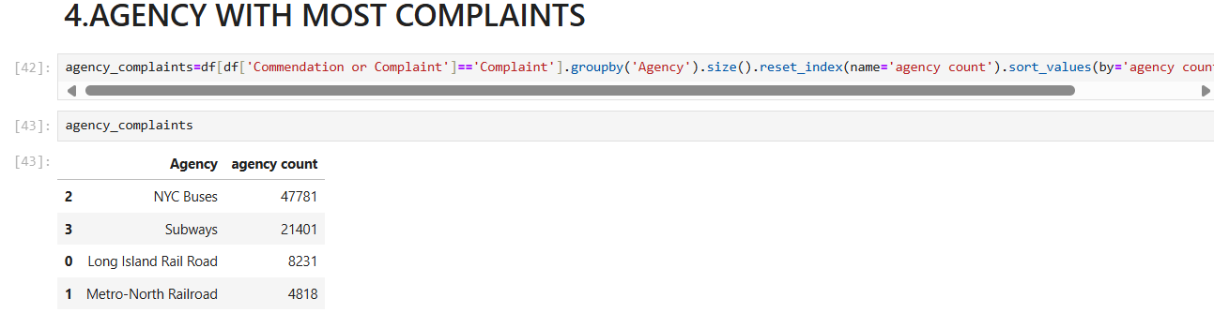
Python Code 1

Slide 10
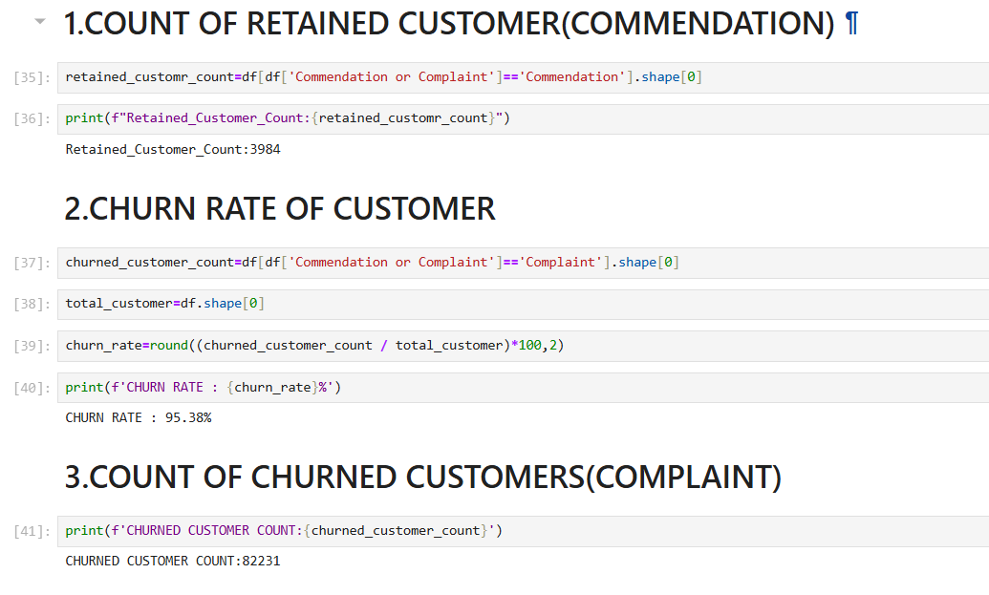
Python Code 2

Slide 11
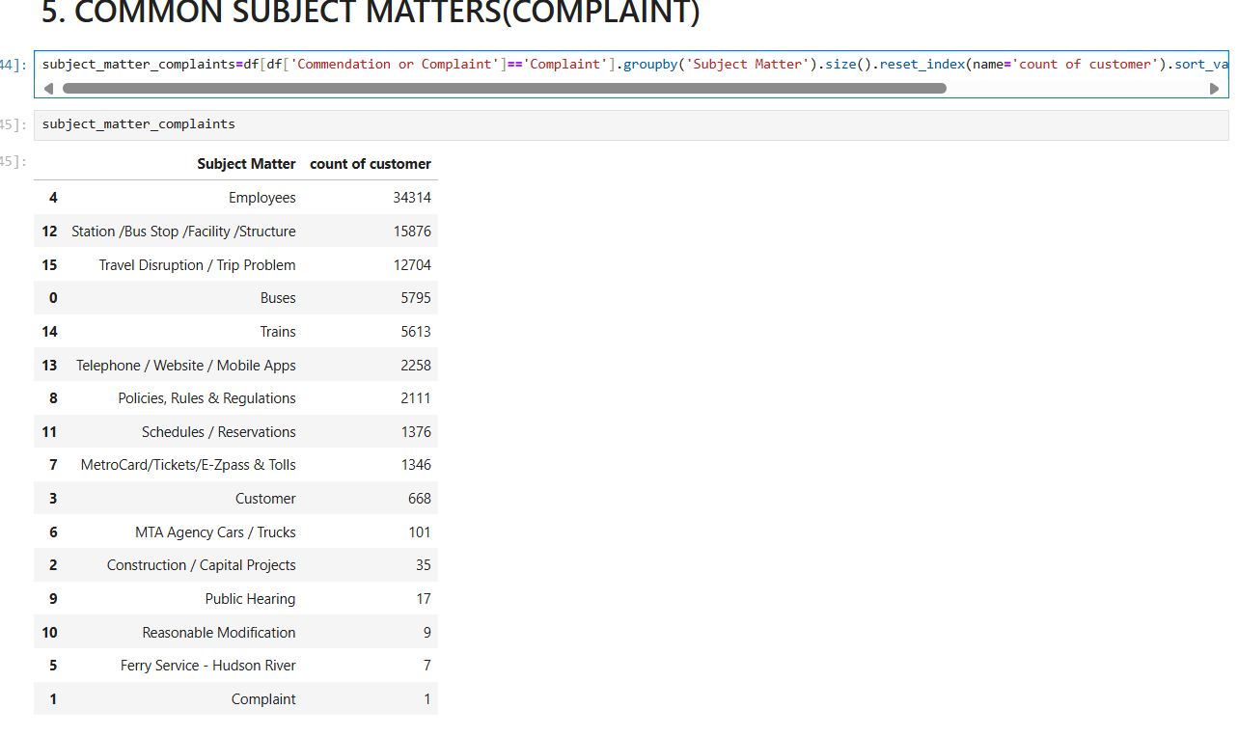
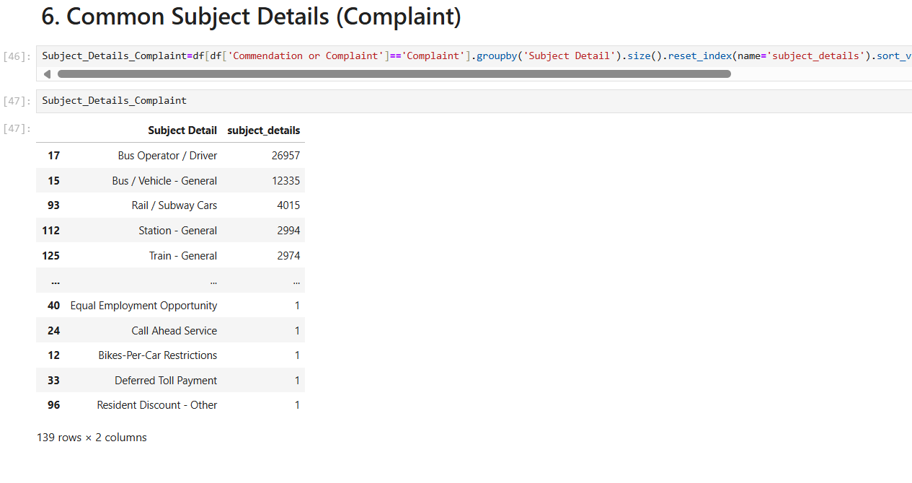
Python Code 3

Slide 12
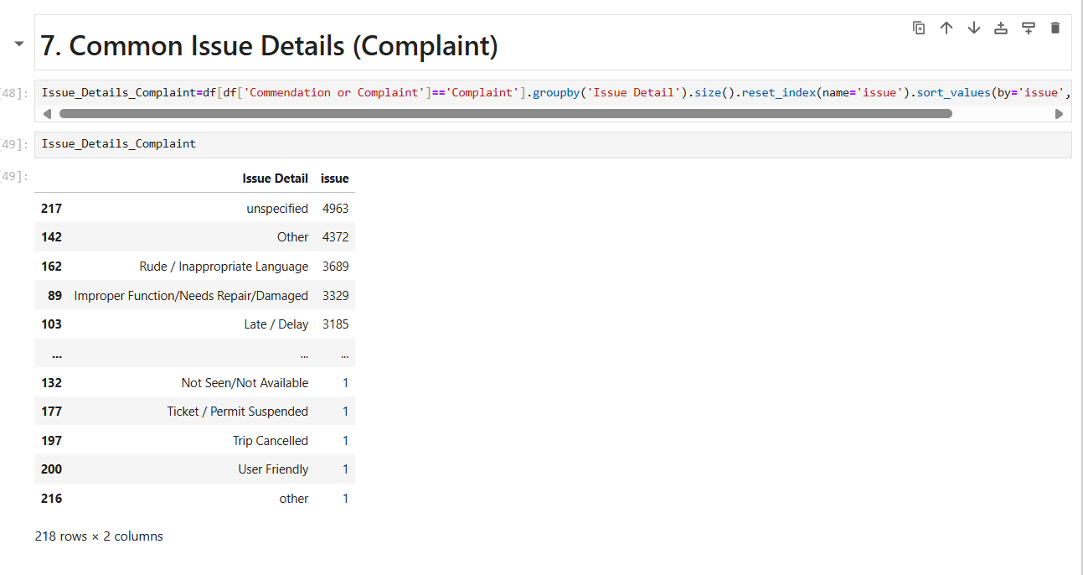
Python Code 4

Slide 13
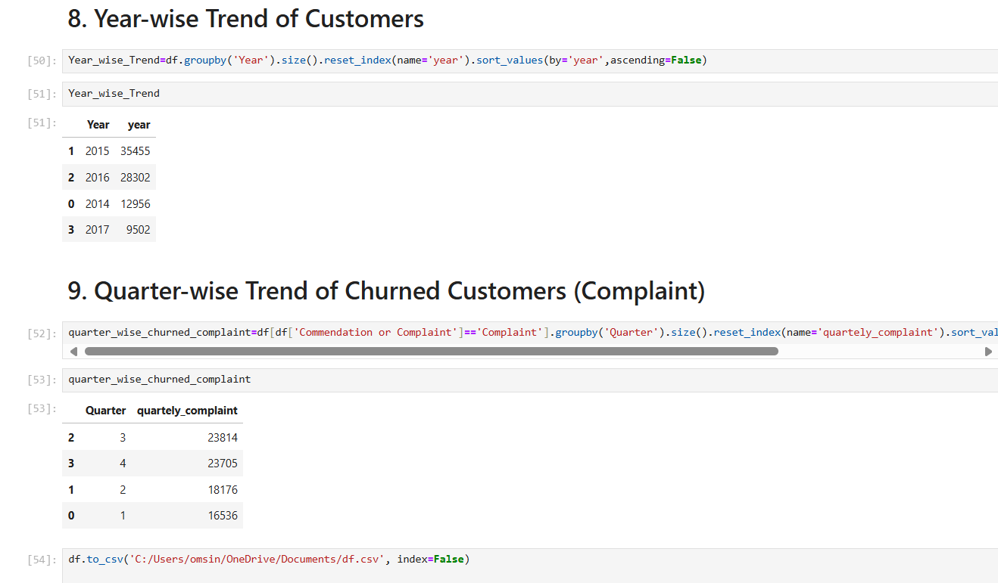
Python Code 5

Slide 14
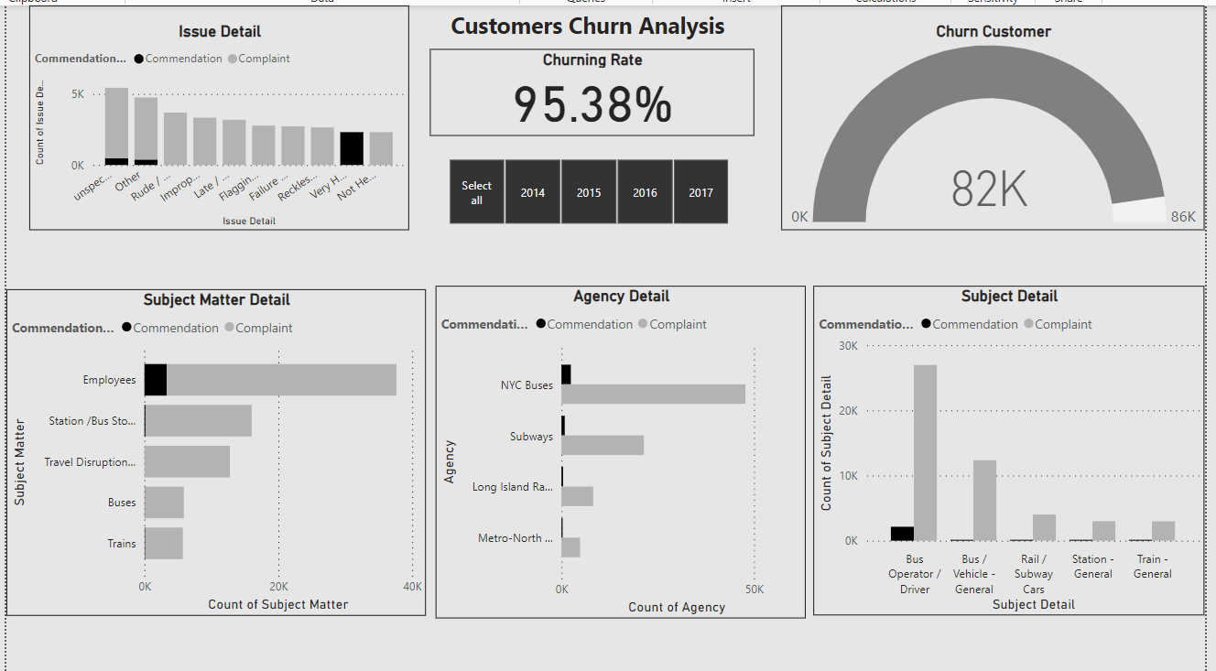
Dashboard

Slide 15
Insights - 1
The customers’ churning rate is very high i.e. 95.38 %. The company may face a huge loss, if it doesn’t tackle the problem on urgent basis.
The NYC Buses agency has the maximum number of complaints, followed by Subways. These agencies are not providing good services to the customers.
Mostly customers are disappointed with the Employees and Station/Bus Stop/Facility/structure services. These need to be tackled in order to decrease the churning rate of customers.
The maximum churning of customers has taken place in the 3rd and 4th quarters (approximately 25% in each quarter).

Slide 16
Insights - 2
Mostly customers face problems with the Bus Operator or Driver and Vehicles.
Specifically, the customers get bothered by the rude behaviour or inappropriate language used by the drivers and malfunctioning of the vehicles, other than the reasons unspecified. The company should seriously take action against such drivers and also repair the malfunctioned vehicles in order to increase the customer retention rate.
It is clear that the customers are not liking the services since year 2015 as the number of customers starts decreasing since year 2015. The number of customers drastically decreases in the year 2017. The customers count in the year 2017 became even lesser than half of the count in the year 2016. The maximum churning of customers has taken place in the year 2017.

